Slide 1


The Impact of Educational
Attainment on Crime Rates
The George Washington Project 3 - Team 1
Dele Akanle, Mary Darab, William Davis, Faisal Dernawi, Alfred Etame, Mohamed Mursal, & Jessica Snowden
January 8, 2025

Slide 2
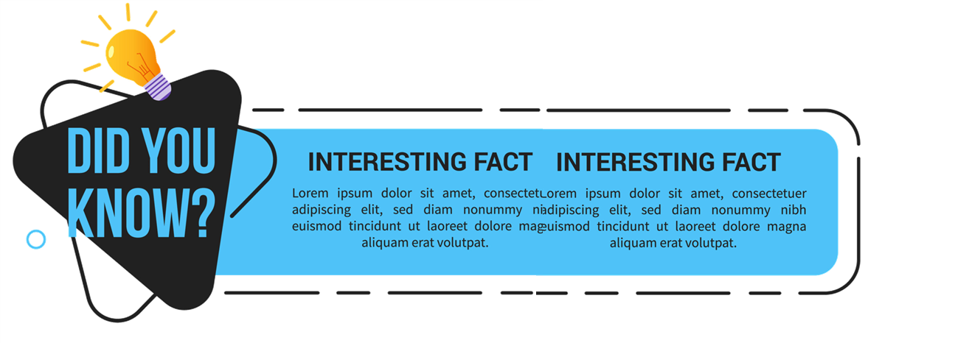
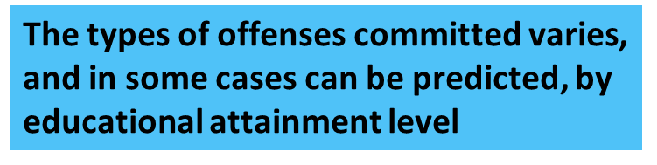
High School Educational Attainment
High school dropouts are 3.5 times more likely than high school graduates to be arrested in their lifetime. (1)
For federally sentenced US citizens with less than a high school degree, drug trafficking (42.0%) was the most common offense, followed by firearms (25.2%), immigration (11.5%), robbery (4.2%), and fraud (4.1%). (2)
College Educational Attainment
Sentenced individuals with an undergraduate or graduate degree are more often convicted for economic or sex offenses than sentenced persons with less education. (2)
Approximately one-third of sentenced individuals with an undergraduate degree are convicted for a fraud offense. (2)
Fraud (42.2%) was the most common offense of conviction among federally sentenced persons with a graduate degree, though medical doctors were equally likely to commit fraud (37.6%) or drug trafficking (36.5%). (2)
References
1: The Relationship Between Incarceration and Low Literacy — Literacy Mid-South
2: Education Levels of Federally Sentenced Individuals | United States Sentencing Commission

Slide 3
Agenda
Intro (1-3) [Dele]
Project Purpose (4-5) [Alfred]
Project Phases (6) [Mohamed]
Data Ingestion (7) [Mary]
Data Cleaning (8-9) [Jessica]
Data Analysis - Map (10) [Faisal]
Data Analysis - Correlation (11-13) [Will]
Analysis Limitations (14) [Faisal, Jessica, Mohamed]
Conclusion (15) [Faisal]

Slide 4

How to Use Education Policy to Break the Cycle of Crime and…
Guide Policing Policies and Community Engagement
Identify Neighborhoods in Need of Intervention
Inform Investment in Educational Programs
Predict Areas in Need of Proactive Prevention
Notes:
Article Link that describes our theme:
Any Biases that could come from data (we can add that part towards the end with limitations and or speak briefly here about it)
Any Brief Limitations

Slide 5

Project Purpose
Purpose: Investigate the correlation between educational attainment and crime rates in the Washington, D.C. area.
Objective: Demonstrate how to utilize educational attainment and crime data to inform decision making and address systemic issues affecting social outcomes.
Hypothesis: As educational attainment increases, crime rate decreases.

Slide 6



Project Phases
Data Ingestion
Data Cleaning
Data Analysis
Datasets include disaggregated data by census tract.
Demographic, sex, and educational attainment data from 2020 Census (ACS) data on Educational Attainment by Race/Ethnicity (S-1501) (census.gov)
Individual crime offense data for all of 2020 for Washington D.C. (data.gov)
Jupyter Notebooks utilizing pandas, RegEx, and other commands to develop accurate and reliable datasets for analysis exported as CSV files.
SQL queries to join CSV files and produce a unified database combining all factors.
MatPlotLib to identify trends and correlations between educational attainment and crime rate.
Interactive visualizations using D3.js and Leaflet to further explore data and investigate trends within individual tracts by choosing features via dropdown menus.

Slide 7


Data Ingestion
Crime Data
Data Elements
Specifications
Data organized by individual offense
Each record has offense type, location data (lat/long, census tract, block, precinct), and timestamp data
CSV file with 27,932 rows
Data Elements
Specifications
Educational Attainment Data
Data organized by census tract
Each tract breaks down population by sex, demographic group, and educational attainment level
CSV file with 3,915 rows

Slide 8

Data Cleaning
Both datasets were cleaned and configured to facilitate a join using census tract as the common data element
Crime data reduced to needed columns in preparation of joining in SQL; exported as CSV
Educational data reduced to needed rows corresponding to total, male, and female population in each tract with columns representing combinations of demographic groups and educational attainment levels; exported as CSV
CSV files ingested into SQL, joined, and schema tables developed to support analytic products
Scripts Available for Demo
Jupyter Notebook: census_data_cleaning
Jupyter Notebook: crime_data_cleaned
SQL Database: grouped_data_code

Slide 9

Final Database Organized by Census Tract includes…
Crime Attributes
Demographic Attributes
Educational Attributes
Offense
Arson
Assault w/Dangerous Weapon
Burglary
Homicide
Motor Vehicle Theft
Robbery
Sex Abuse
Theft F/Auto
Theft/Other
Total
Location
Latitude
Longitude
Sex
Female
Male
Total
Race
AIAN (American Indian & Alaska Native)
Asian
Black
Hispanic
NHPI (Native Hawaiian & Pacific Islander)
Multiracial (2 or more)
Other/Unknown
White
Total
Attainment Level
Less than High School
High School
College

Slide 10
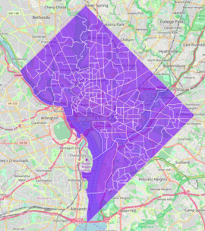
Data Analysis
Drop Down Menus (Educational Attainment, Offence Type, Sex)
Interactive Map with Tracts
Clicking on Each Tract Shows Additional Details for That Tract
Scripts Available for Demo
Jupyter Notebook: correlation_analysis
Website: In Work

Slide 11
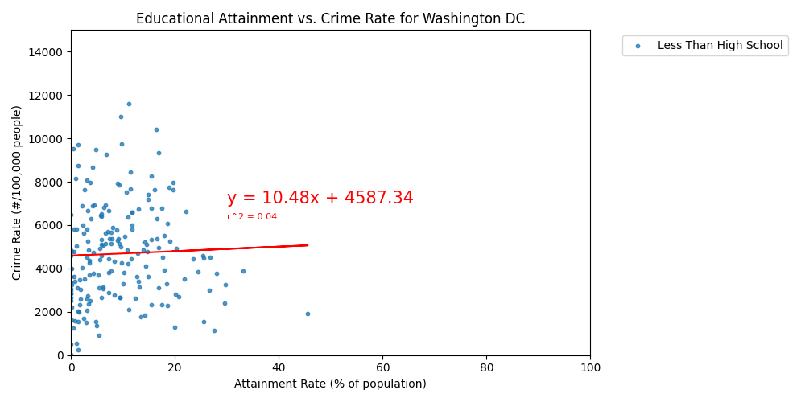
Data Analysis
Less Than High School
Observations
Correlation factor, even after removing outliers, is nearly 0
Analysis does show a positive slope (+10.48) to the trend line, indicating that the larger the population with less than a high school degree, the higher the crime rate
Notes:
Key Visualizations
Bar Graphs: Compare crime rates across regions with varying educational attainment levels.

Slide 12
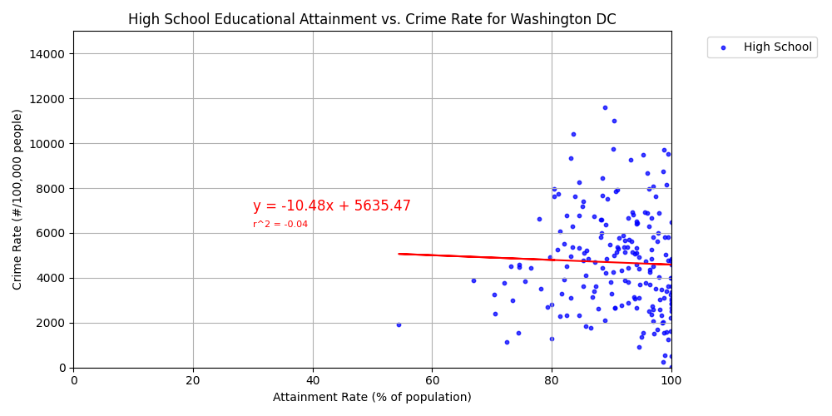
Data Analysis
High School
Observations
Correlation factor, even after removing outliers, is nearly 0
Analysis does show a negative slope (-10.48) to the trend line, indicating that the larger the population with a high school degree, the lower the crime rate
Notes:
Key Visualizations
Bar Graphs: Compare crime rates across regions with varying educational attainment levels.

Slide 13
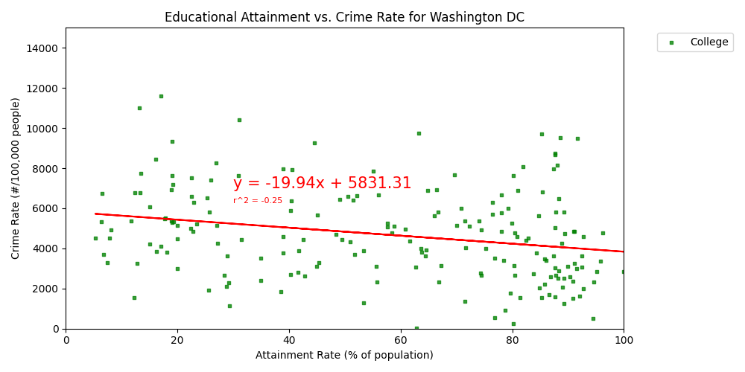
Data Analysis
College
Observations
Correlation factor even after removing outliers, is still low (0.25)
Analysis does show a negative slope (-19.94) to the trend line, indicating that the larger the population a college degree, the lower the crime rate
Notes:
Key Visualizations
Bar Graphs: Compare crime rates across regions with varying educational attainment levels.

Slide 14
Analysis Limitations
Crime Type
Tract Size
Our analysis does not account for type of crime committed (all offenses counted); based on academic literature, disaggregating by offense may yield different correlations
Census tracts can be very small, and are designed to capture populations between 1,200 and 8,000, with the ideal size being 4,000.
Our analysis assesses relationship of crime rate to population in each tract; however, there is no indication that people only commit crimes within their tract.
Utilizing larger geographic areas may yield different correlations.
Offender Data
Crime data does not include the type of offender (sex, race). If this could be added to analysis, it would enable better analysis by looking at individual population groups.
Source Data
Census data (ACS) uses estimations to determine relative population in each tract and could be subject to bias as a result of margins of error; census data is also voluntary and tends to not completely capture homeless or low socio-economic groups which have less access to education.

Slide 15

Conclusion
While data analysis does show crime rate decreases when more people are educated; how that data can be used to allocate resources and inform public policy needs additional investigation.
Increased data about offenders (sex, race) would enable ability to link crime rates to specific populations in the Washington, D.C., demonstrating where gains could be most significant.
Such data would inform targeted programs and investment in areas and with populations that would benefit from improved educational attainment.
Notes:
Conclusion
High crime = jail time ….

